Slide 1
FPGA Designed Snake Game
Huo Yanqi & Yu Chengyi
Our Brand Logo
Snake game using FPGA program design

Slide 2

Beuaray Corp.
Project Background
Table of Contents
Design ideas and Implementation process
Cover design
Topics Covered
In-game screens
Our Brand Logo
FPGA project demonstration
Conclusion and Drawbacks
Table of contents
02

Slide 3
Beuaray Corp.
Project Background
The goal of this design experiment was to implement a classic snake game on an FPGA. The background of the project is that with the continuous development of FPGA technology, more and more classic games are ported to FPGAs to achieve higher performance and lower power consumption. The goal of this experiment is to design a snake game with good user experience and high performance.
Our Brand Logo
Logo History
03

Slide 4
Beuaray Corp.
Design ideas and implementation process
Our Brand Logo
About the Logo
04

Slide 5
Beuaray Corp.
Design ideas
Firstly, the demand analysis of the snake game is carried out to clarify the basic functions and requirements of the game. Then, design the overall architecture of the game according to the requirements, including game logic, interface display, input processing and other parts. Next, choose the appropriate FPGA development tools and programming languages, such as Vivado and Verilog. Finally, the code, simulation verification and integrated wiring are written to complete the game design of the snake on the FPGA.
Our Brand Logo
Symbols and Meanings
05

Slide 6
Beuaray Corp.
Implementation
(1) Logical design: Write Verilog code to implement the core logic of the snake game, including snake movement, food generation, collision detection, etc.
(2) Interface design: Design the interface of the game, including the background, the image of the snake, the image of the food, etc. Using appropriate image processing techniques, the image data is loaded onto the FPGA.
(3) Input processing: design input interface to receive the user's keyboard input, such as moving up and down, left and right, etc. Convert the input signal into a format that can be recognized by the game logic.
(4) Simulation verification: Use simulation tools such as Quartus II to simulate and verify the design to ensure the correctness and stability of the game logic.
(5) Cabling and downloading: Cabling the designed game logic and other modules to generate a file. The file is then downloaded to the FPGA chip for real-world testing.
Our Brand Logo
The Beuaray Corp. Colors
06

Slide 7
Beuaray Corp.
Our Brand Logo
In-game screens and Cover Design
About the Logo
07

Slide 8


Beuaray Corp.
Cover Design
Our Brand Logo
Logo Font
08

Slide 9
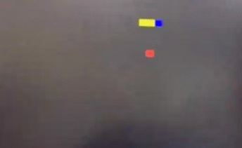
Beuaray Corp.
In-game screens
Our Brand Logo
About Beuaray Corp.
09

Slide 10
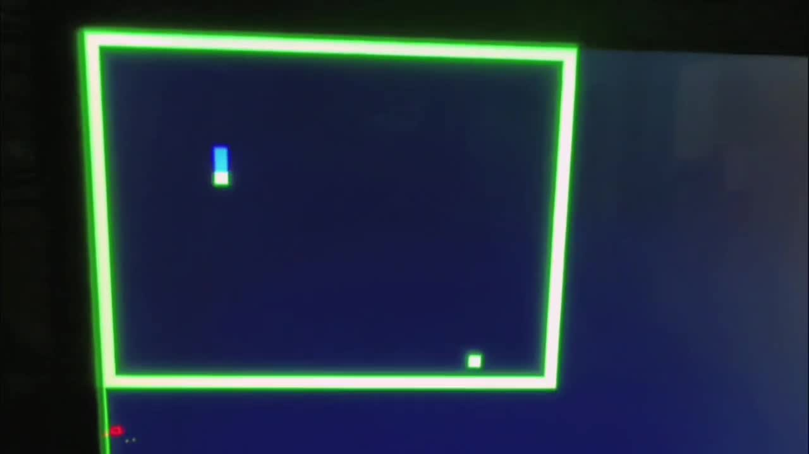
Beuaray Corp.
Cover Design
Our Brand Logo
Logo Font
10

Slide 11
Beuaray Corp.
Our Brand Logo
FPGA project demonstration
Exclusion Zones
11

Slide 12
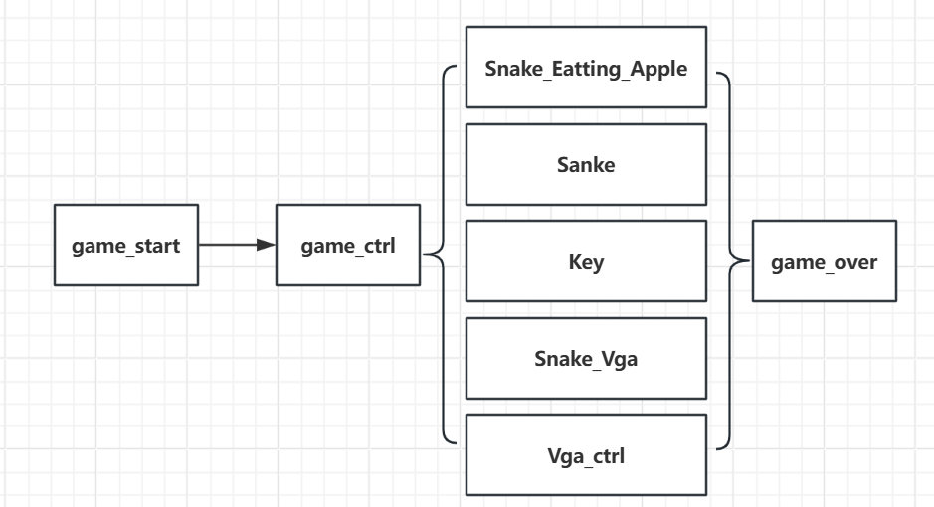
Engineering module category
Beuaray Corp.
Our Brand Logo
Reminders
12
Notes:
Here is the engineering module category. The first module is game_start part, it is mainly responsible for the game's start screen. And the last module is game_over, it is mainly responsible for the game’s over screen.
1. game_ctrl module: mainly complete the game start, run, end and other states.
2. Snake_Eatting_Apple module: mainly complete the state judgment of snakes eating apples.
3. Snake module: It mainly completes the judgment of the snake's running trajectory, wall appearance, snake hitting the wall, and other states.
4. Key module: complete the debounce processing of the up, down, left and right buttons and the effective output of the buttons.
5. Snake_Vga module: Complete VGA display of snake body, snake head, apple and wall color.
6. vga_ctl module: complete the control and output of VGA.

Slide 13
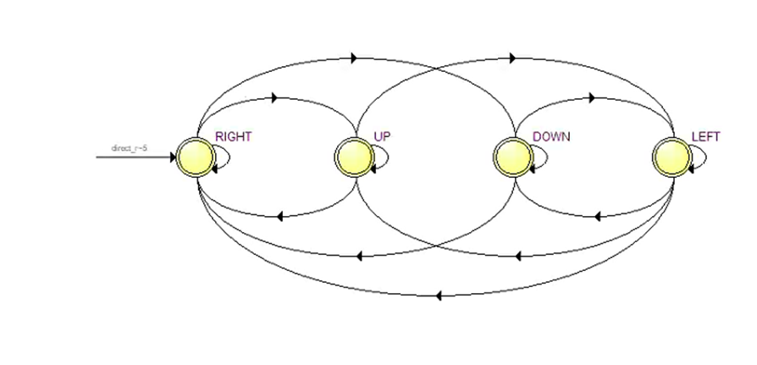
Beuaray Corp.
Snake game running state diagram
Our Brand Logo
Logo Variations
13
Notes:
This is a flowchart for controlling the movement of the snake during gameplay. Here are four states, turn right, turn left, up and down. You can see that the four different states are interchangeable with each other.

Slide 14
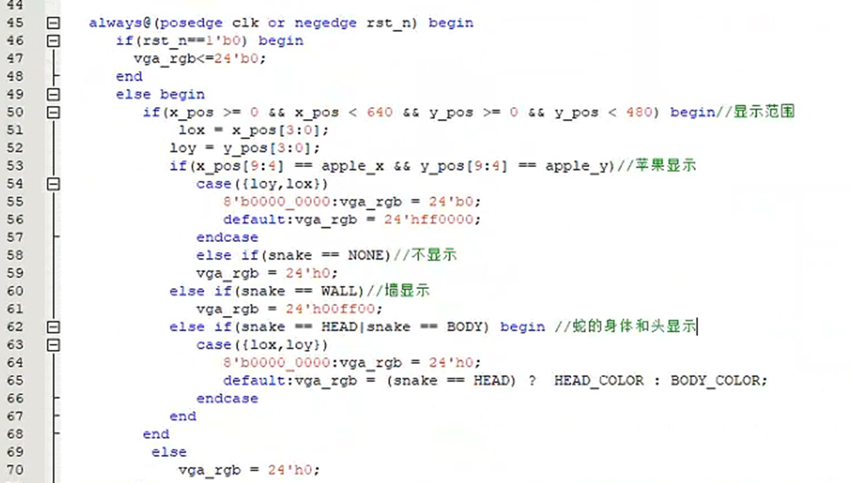
The basic display of the game
Beuaray Corp.
Display of snake body, wall, apple
Our Brand Logo
Logo Application
14
Notes:
This part of the code is some of the basic code. The main purpose of this code is to complete the display settings of the game, such as the display range, the random display of apples, the display of walls, the display of the snake's head and body.

Slide 15
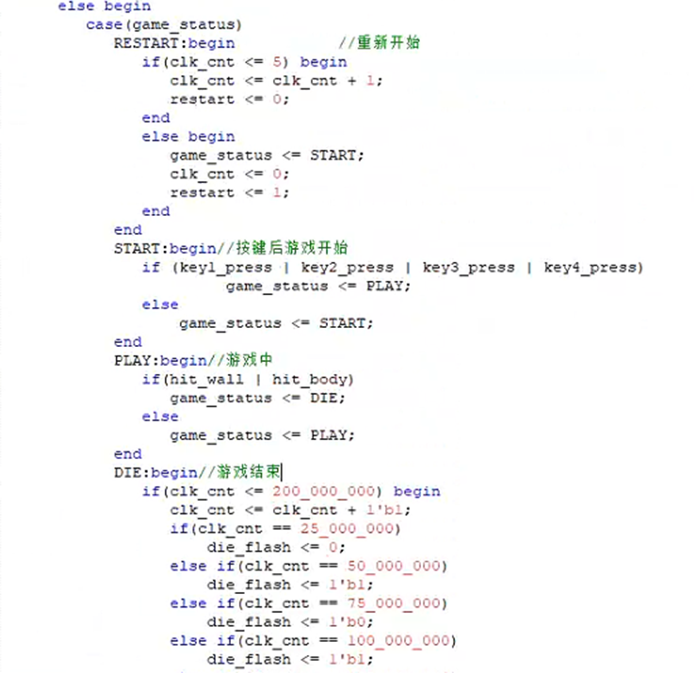
Beuaray Corp.
Post-death state transition
The game restarts:
automatically enters START after 5 clocks, enters PLAY by pressing the button, hits the wall or hits the body, enters the DIE state, and automatically enters the RESTART state after 2 seconds
Our Brand Logo
Logo Positioning
15
Notes:
This part of the code is to implement the code for the snake's respawn state after death.

Slide 16
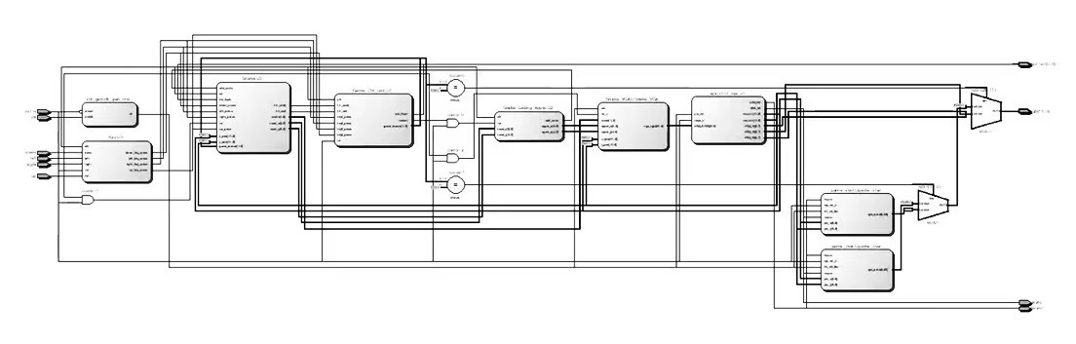
Beuaray Corp.
Planned RTL view
Our Brand Logo
Logo Application
16
Notes:
This is the RTL view and simulation results of the completed code so far

Slide 17
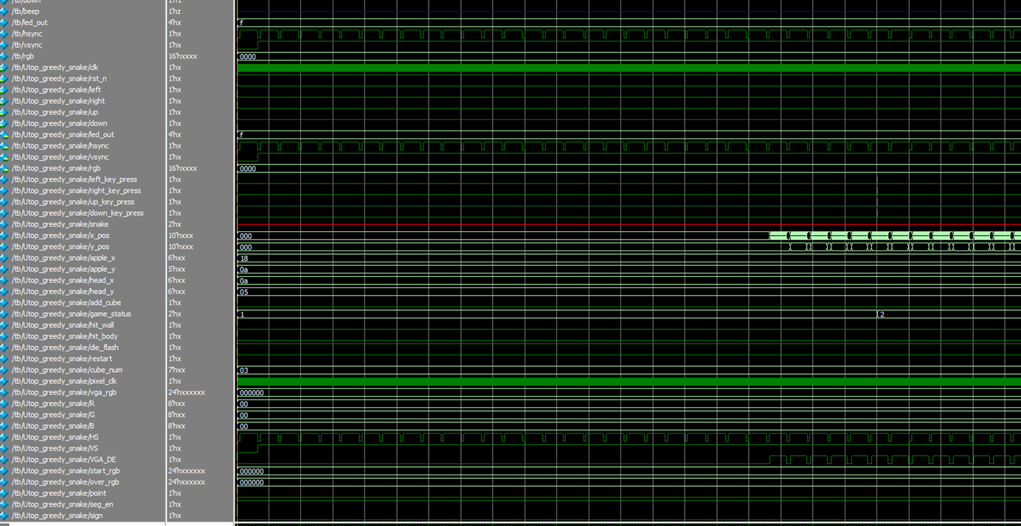
FPGA simulation
Beuaray Corp.
Our Brand Logo
Logo Application
17

Slide 18
Conclusion
Beuaray Corp.
Through this experiment, we successfully designed and implemented a classic snake game on an FPGA. This not only improved our FPGA development skills and experience, but also laid the foundation for us to develop more complex FPGA games in the future.
In the process of experimentation, we learned how to perform requirements analysis, design idea planning, code writing, simulation verification and actual testing. These steps are very important for any FPGA development project.
We also learned how to develop using FPGA development tools such as quartus ii and programming languages such as Verilog. These tools and languages are important for improving development efficiency and performance.
In the future study and work, we should continue to learn FPGA technology and game development technology in depth to develop more and better FPGA games and other applications. At the same time, we also need to focus on teamwork and communication in order to better complete project tasks.
Our Brand Logo
Logo Application
18

Slide 19
Beuaray Corp.
Drawbacks
I haven't fully completed a perfect snake game yet, and here's why:
Failure to design the presence of obstacles within the site
Failed to design the snake body to be interesting enough
The setting for the growth of the snake body still needs to be refined
Our Brand Logo
Logo Application
19

Slide 20

Beuaray Corp.
Thanks for listening
Our Brand Logo
Download the Resources

